Slide 1
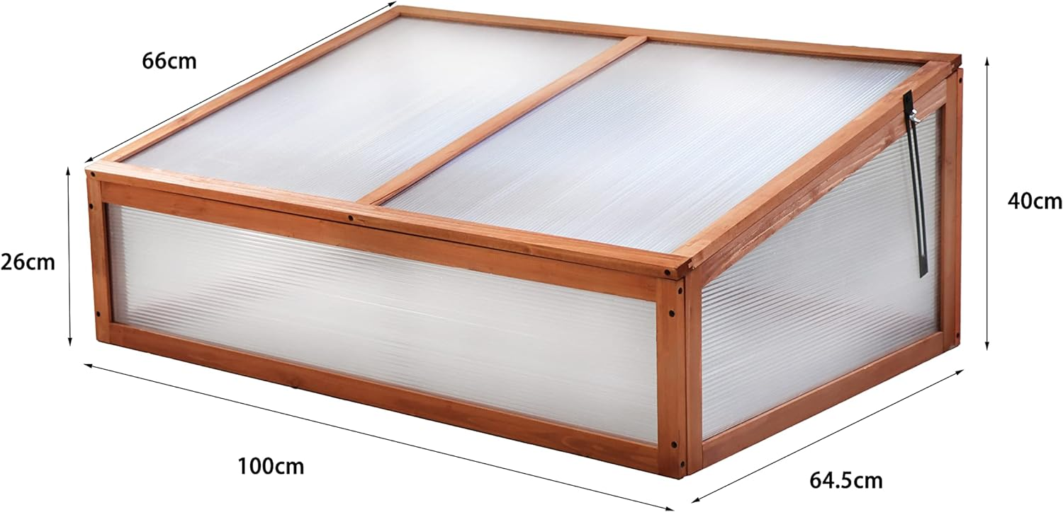
Design Overview
Additional sketches (FBD or details)
Sketch of how the mechanism fits on the frame
LJ386

Slide 2
Mechanism Details
Dimensions
Motor Selection
What are the dimensions of the rack and pinion?
Which motor did you select? Why?
Integration
Tolerances
How does the motor fit with the overall system? How is all secured in place?
Did you consider tolerances in your design?

Slide 3
Temperature Control
Description & Calculations
Circuit (optional)

